Slide 1
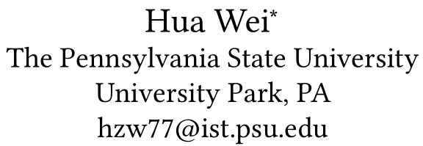



郑凯文
IntelliLight A Reinforcement Learning Approach for Intelligent Traffic Light Control
2018 KDD
第24届ACM SIGKDD知识发现与数据挖掘国际会议论文集
Notes:
EDBT / ICDT研讨会主席
Nikolaus Augsten，奥地利萨尔茨堡大学
第28届地理标志 - 数据库基础研讨会

Slide 2
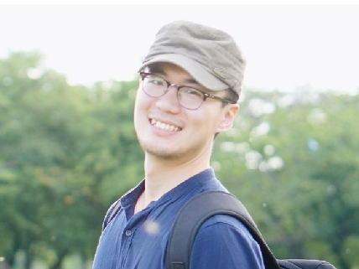

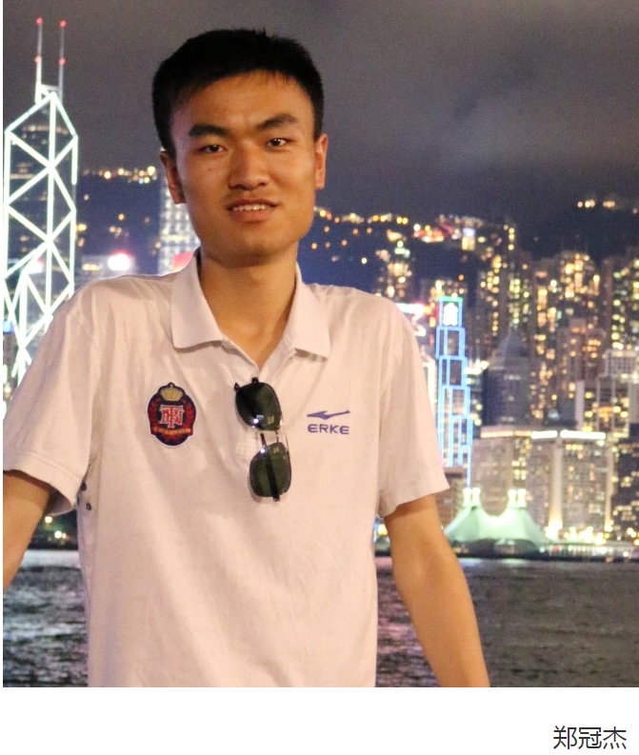
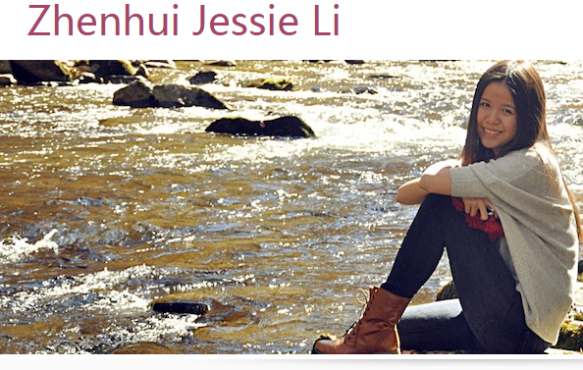

作者

Slide 3
Outline
1
Introduction
2
Our Approach
3
Experimental
4
Conclusion

Slide 4
Introduction
1

Slide 5
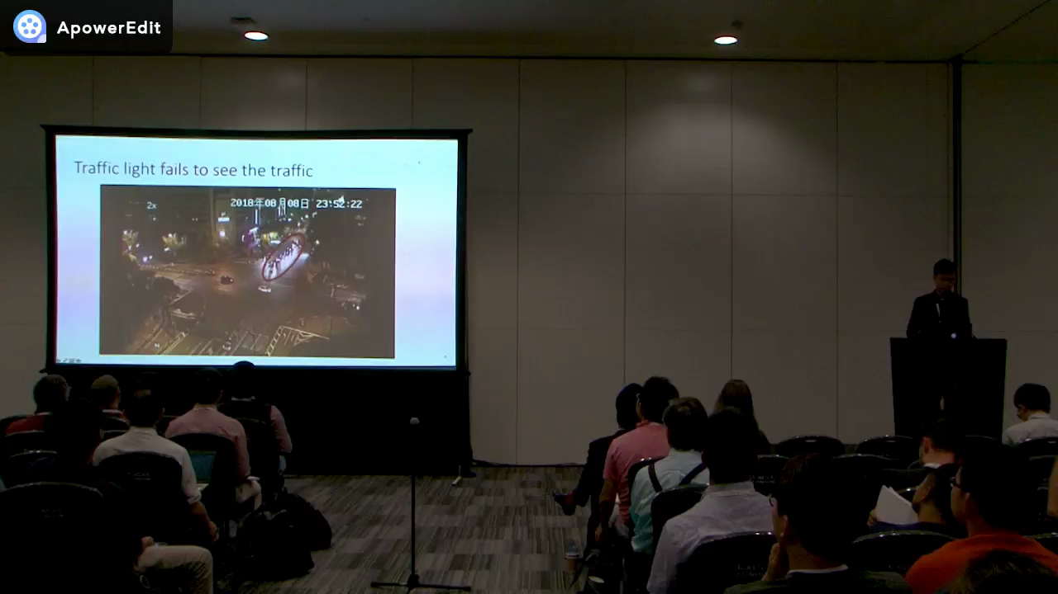
Introduction
traffic congestion cos ts Americans $124 billion a year, according to a report by Forbes in 2014

Slide 6
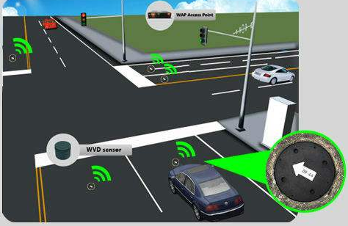
Introduction
The current traffic signal contol systems
SSCATS
- Sydney Coordinated Adaptive Traffic System
- Developed in 1980s
- Each traffic signal: 8~16 manually
designed signal palns.
- Problems:
Not learned by data
Use loop sensor data to choose the paln

Slide 7
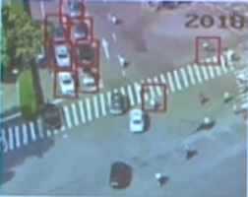
Introduction
Yesterday
Today
loop sensor data
Camera data
Only count the vehicle when it passes the sensor.
Show positions of all vehicles,pedestrain and bicycles real-time.

Slide 8

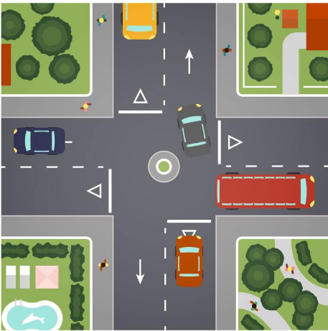
Introduction
Traditional Transportation
Reinforcement Learning
Optimization under assumptions
of traffic model
Directly learning from real-world data
minimize duration subject to
traffic model
Action
Signal plan = func(loop sensor data)
observation
Assumptions do not apply in the real world!

Slide 9
Our Approach
2

Slide 10
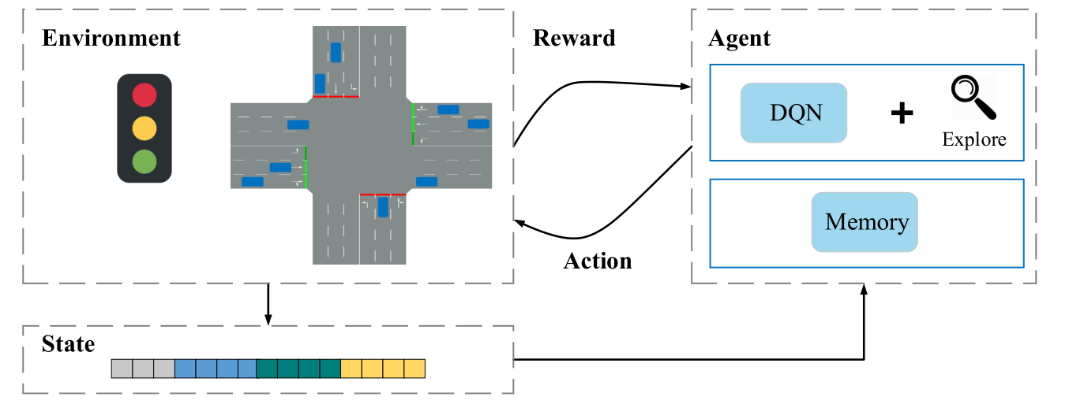
Our Approach
The basic idea of deep reinforcement learning framework
Action
observation
Environment : composed of traffic light phase and traffic condition
state : a feature representation of the environment
Reward : queue length , average waiting time , sum of delay
Action : keep the signal or change the signal

Slide 11
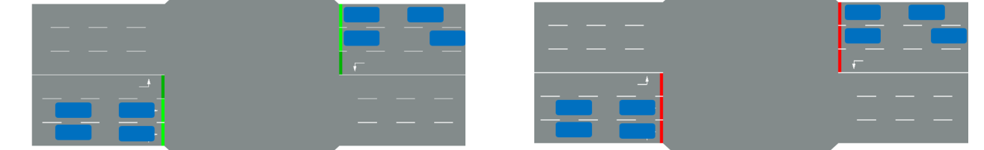
Our Approach
Problem 1:
keep the signal
change the signal
Phase
Phase
1000 + feature
1000 + feature
Will make the same prediction

Slide 12
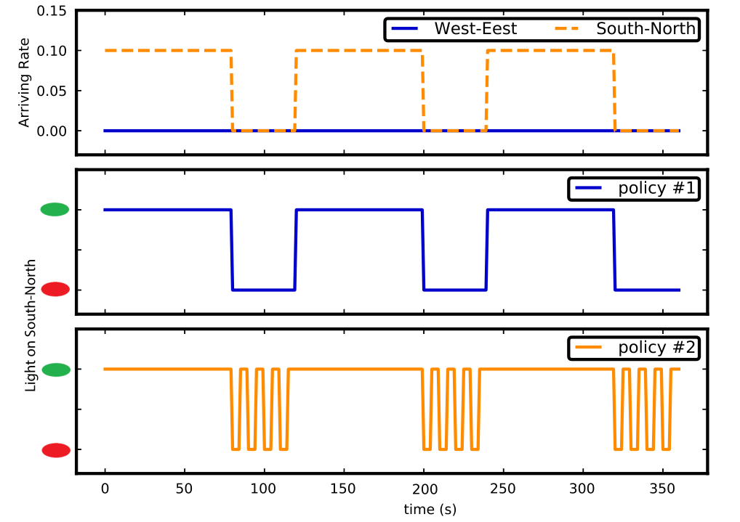
Our Approach
The basic idea of deep reinforcement learning framework
Problem 2 :

Slide 13
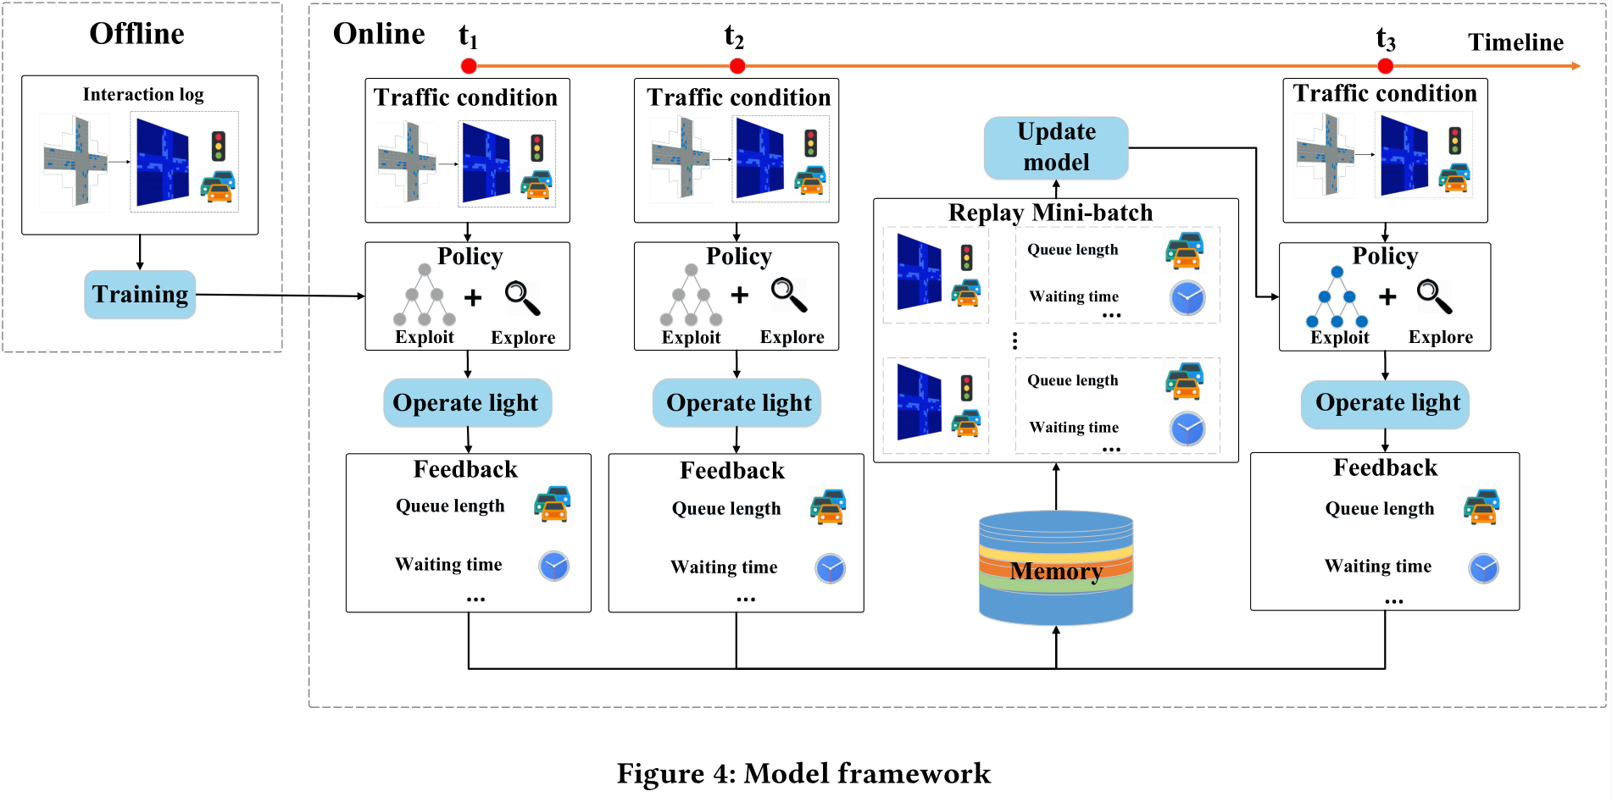
Our Approach

Slide 14
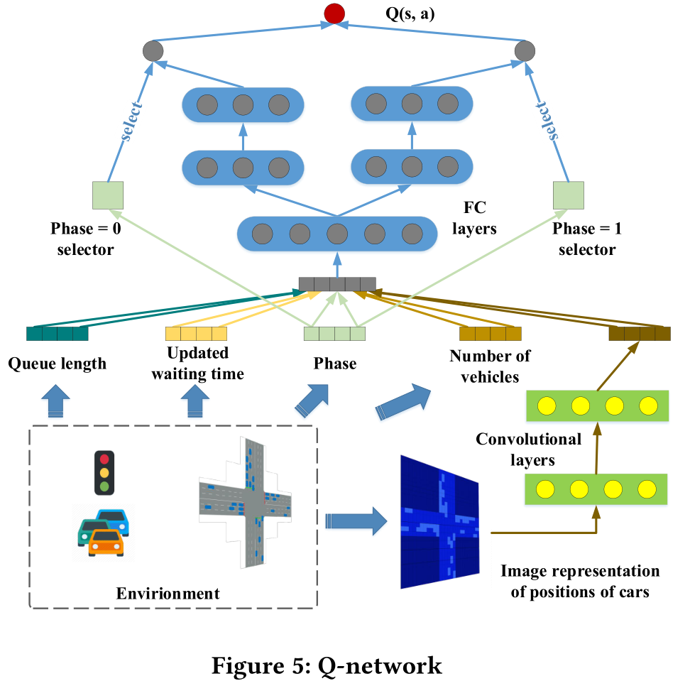
Our Approach
Solve Problem 1:

Slide 15
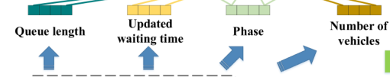
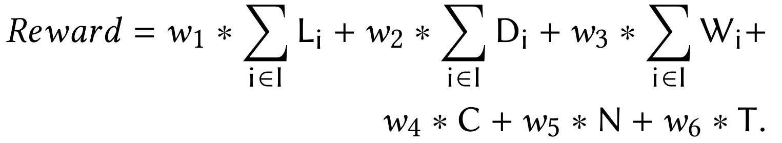
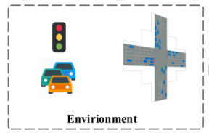
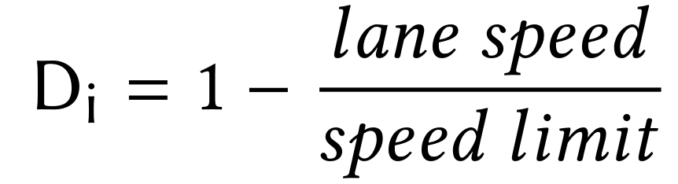
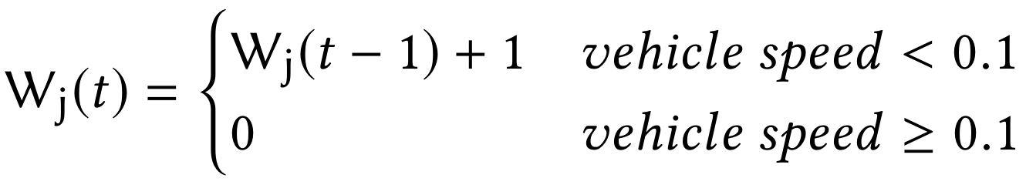
Our Approach
Solve Problem 2:
∑ L_{i} :Sum of queue length L
∑ D_{i} : Sum of delay D
∑ W_{i} : Sum of waiting time W
C : Indicator of light switches C ，C = 0 Keep， C = 1 Change
N : 在动作a之后的时间间隔Δt期间通过交叉路口的车辆总数N
T : 在动作a之后的时间间隔Δt期间通过交叉路口的车辆总数T的总行驶时间，定义为车辆在接近车道上花费的总时间（以分钟为单位）

Slide 16
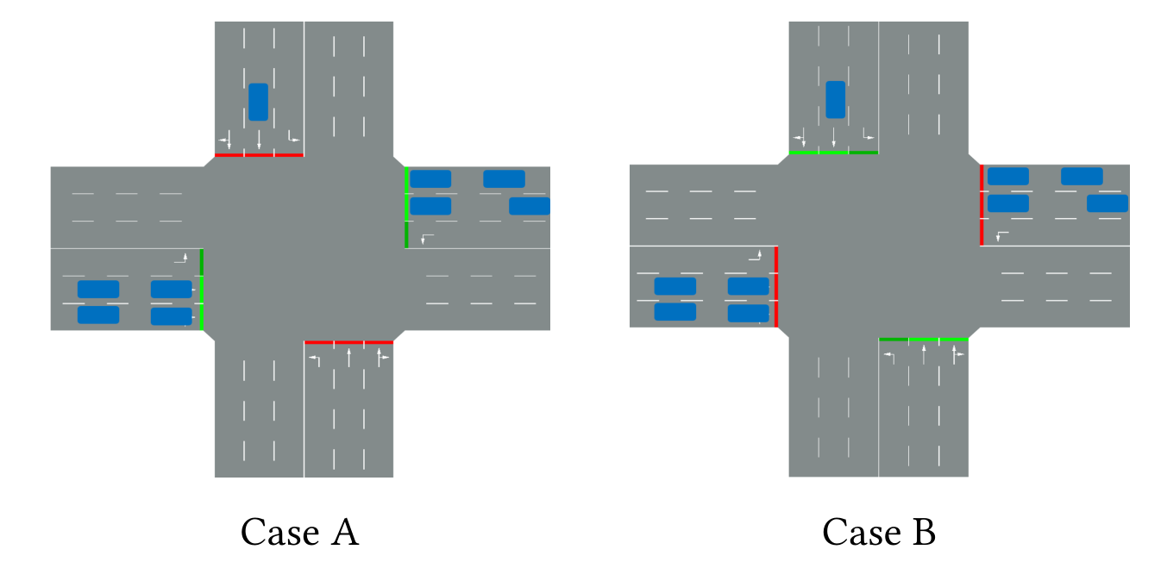
Our Approach
Reward = -0.2*L - 0.7*W - 0.2*D - 0.1*C + 0.3*N - 0.03*T
Reward (Case A Keep ) ≈ 2.2
Reward (Case A Change ) ≈ - 8.9
Reward (Case B Keep ) ≈ - 8.8
Reward (Case B Change ) ≈ 2.1

Slide 17
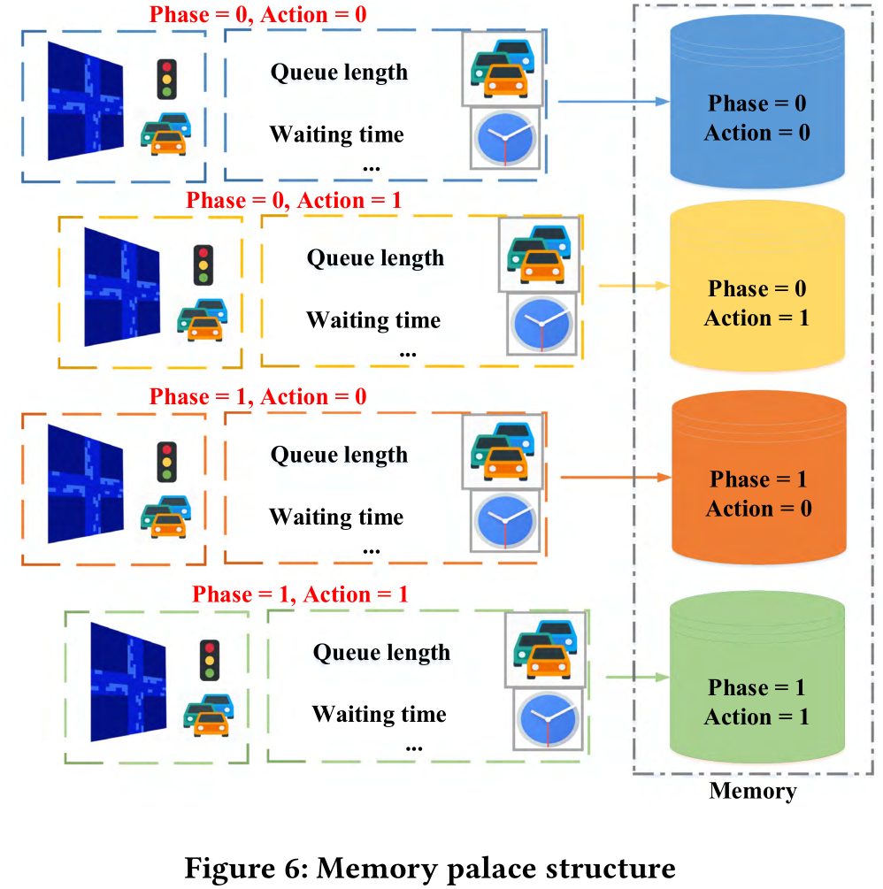
Our Approach
Get balance samples for training

Slide 18
Experimental
3

Slide 19
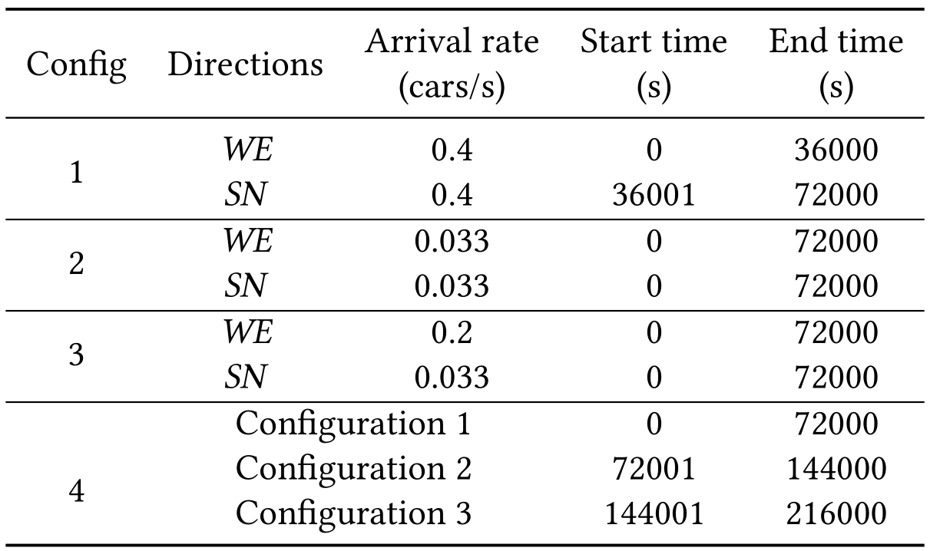
Experimental
SUMO
(Simulation of Urban MObility)

Slide 20
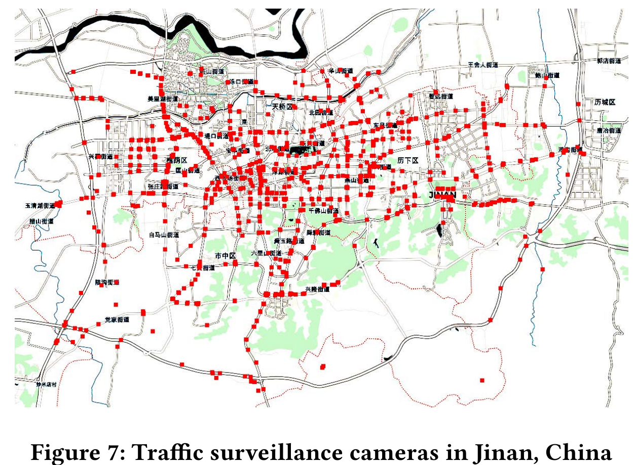
Experimental

Slide 21
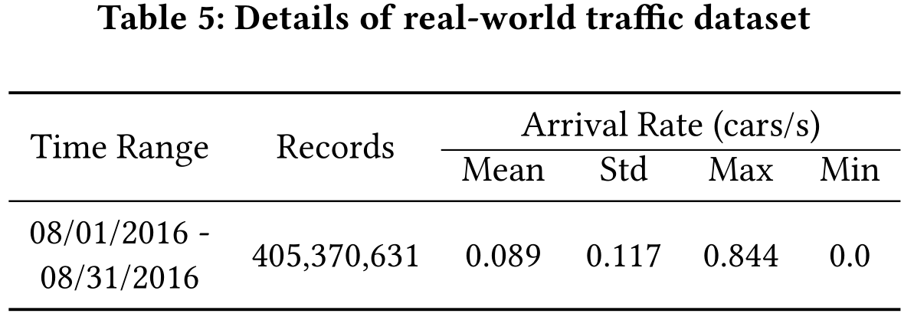
Experimental
我们使用通过24个交叉口的车辆数量作为实验的交通量，因为只有这些交叉口有连续的数据。
real-world traffic dataset → SUMO

Slide 22
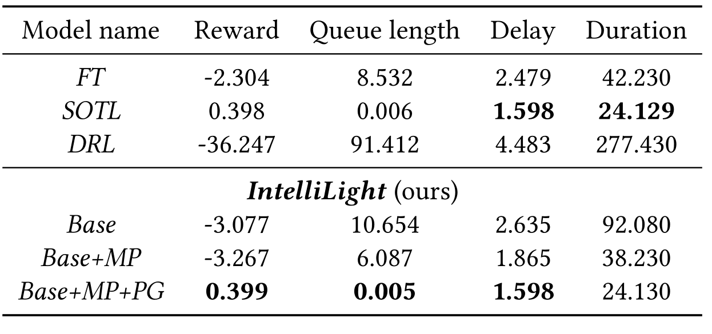
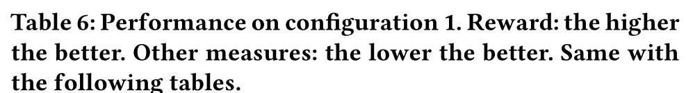
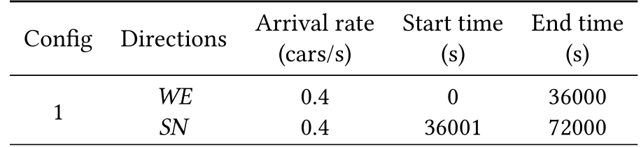
Experimental
Fixed-time Control (FT)
Self-Organizing Traffic Light Control (SOTL)
Deep Reinforcement Learning for Traffic Light Control (DRL)
Memory Palace
Memory Palace and Phase Gate

Slide 23
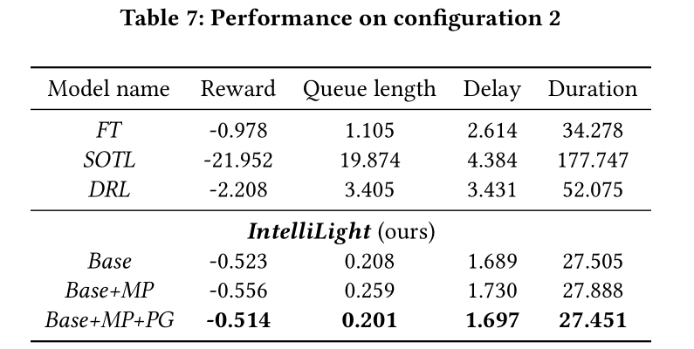
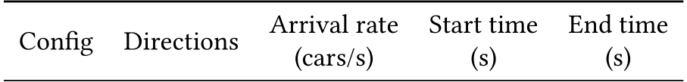
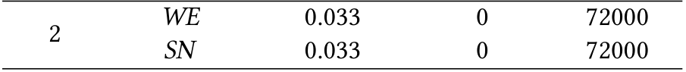
Experimental

Slide 24
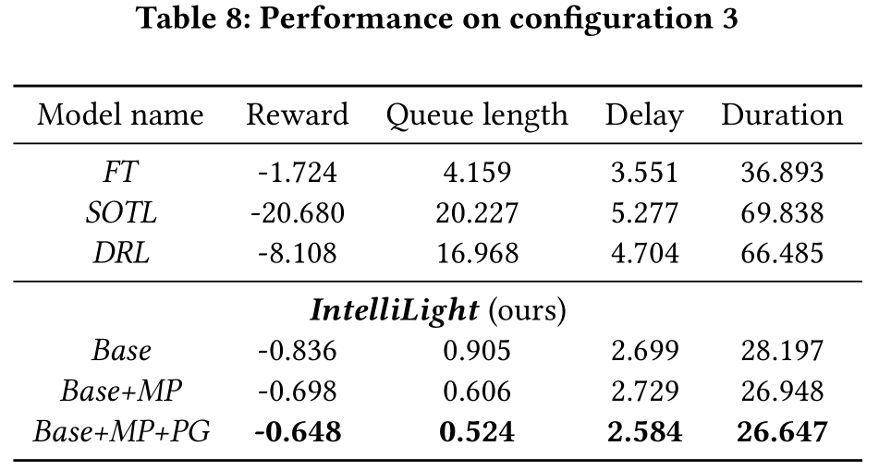
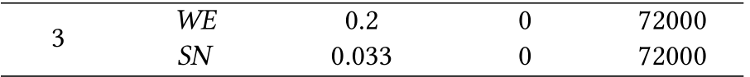
Experimental

Slide 25
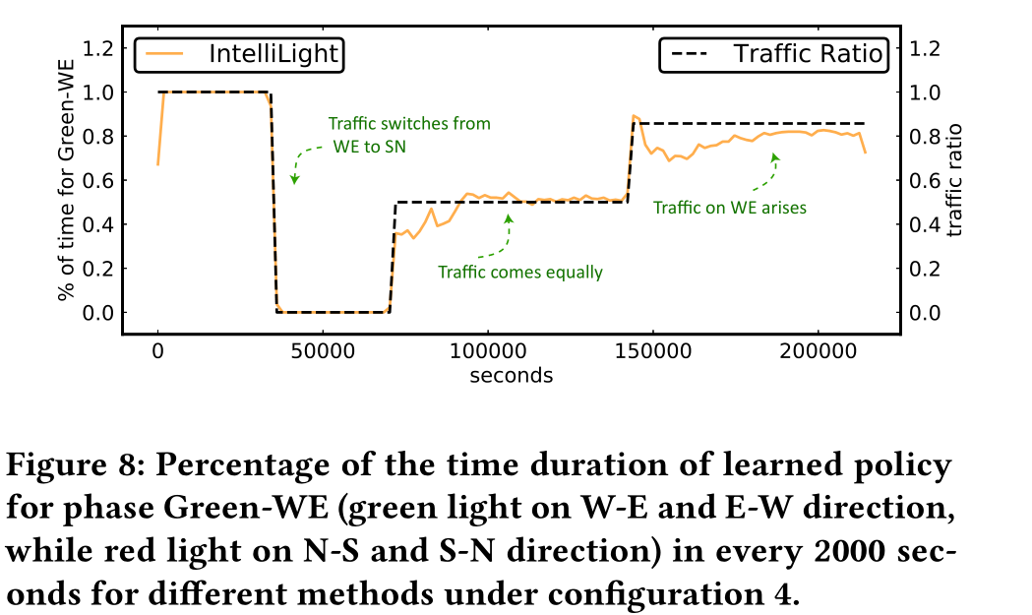
Experimental

Slide 26
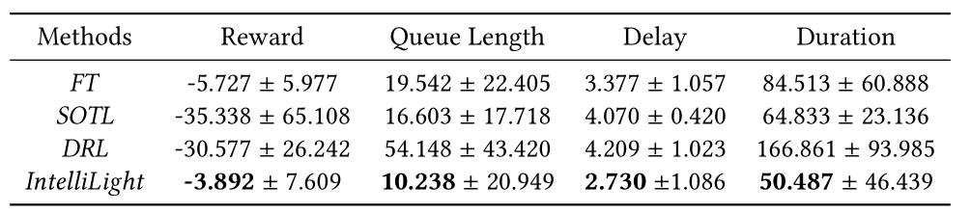
Experimental

Slide 27
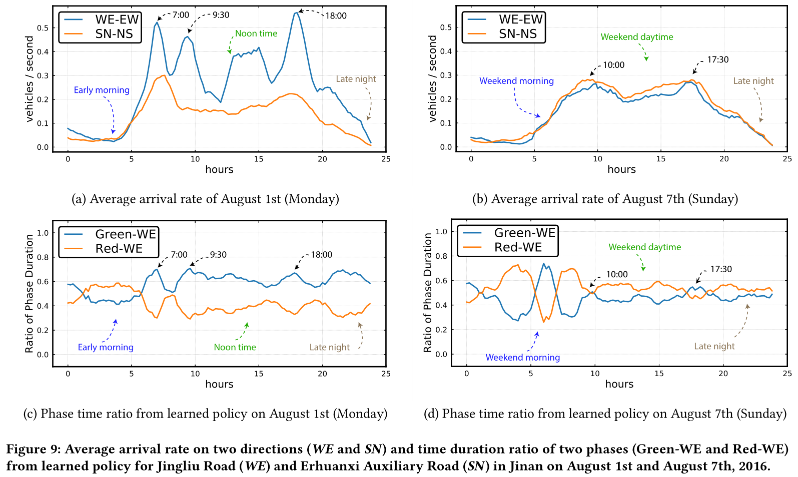
Experimental

Slide 28
Conclusion
4

Slide 29
Conclusion
IntelliLight
Problem
Phase
Phase
1000 + feature
1000 + feature
Will make the same prediction

Slide 30
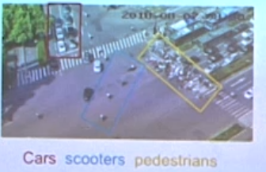
Conclusion

Slide 31
Thanks for your time!

